Slide 1
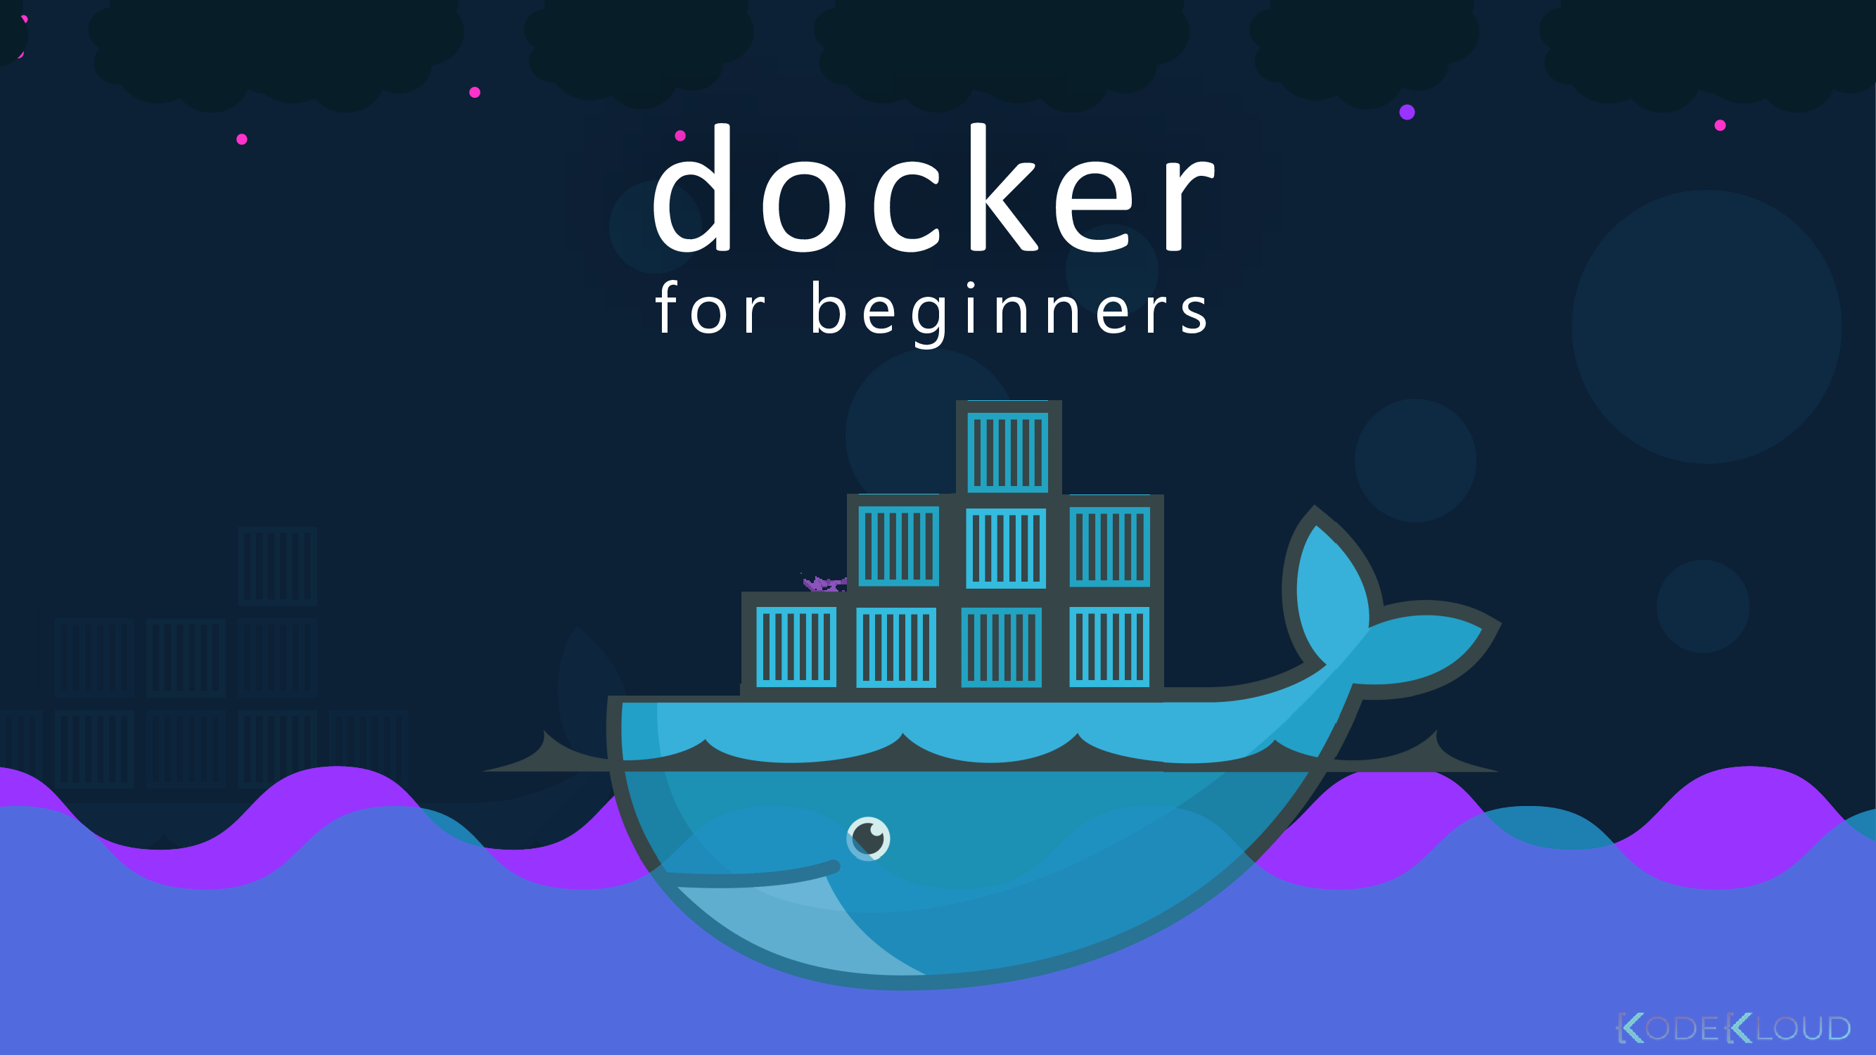


BY: Saad Al-Eraqy

Slide 2
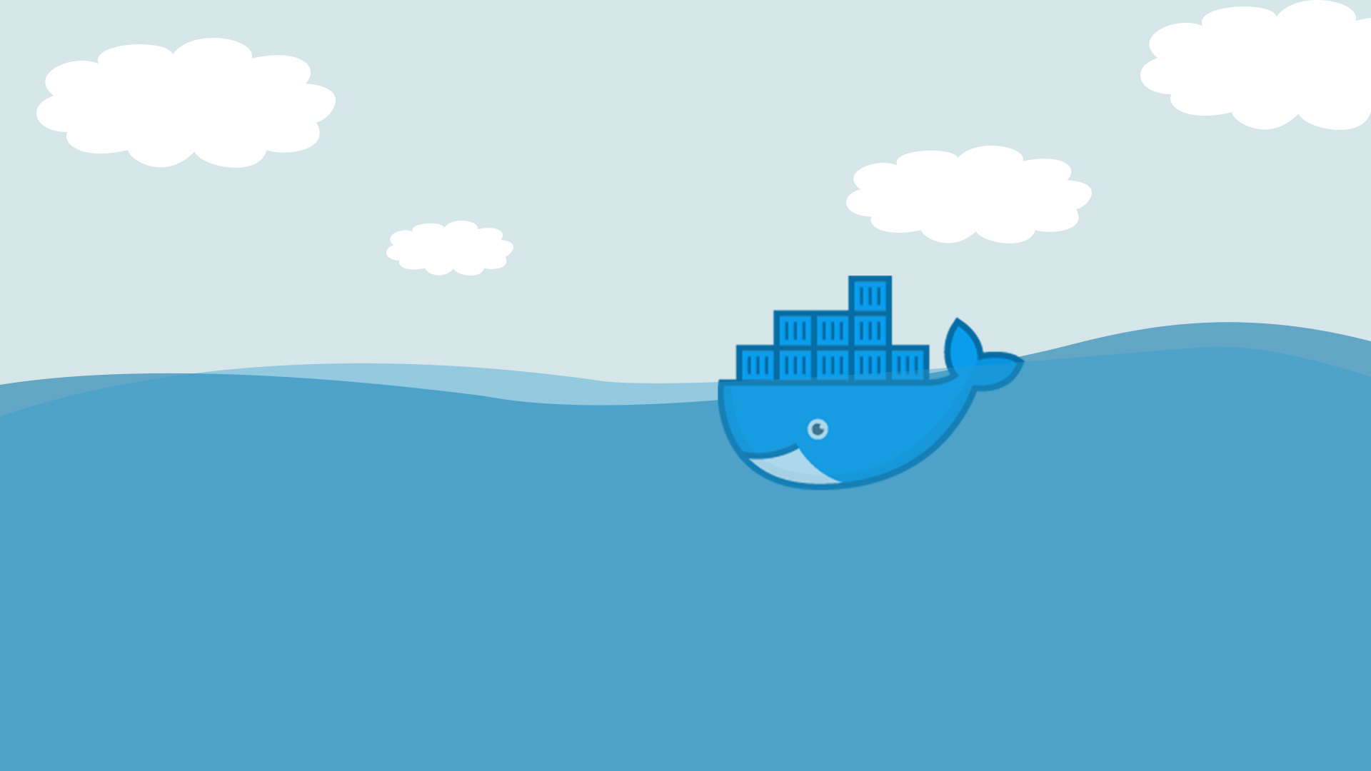
Agenda :
Applications lifecycle before and After docker.
containerization vs virtualization.
Image VS container.
What is docker ?.
Install Docker .
Docker Commands.
Docker volumes.
Labs.

Slide 3
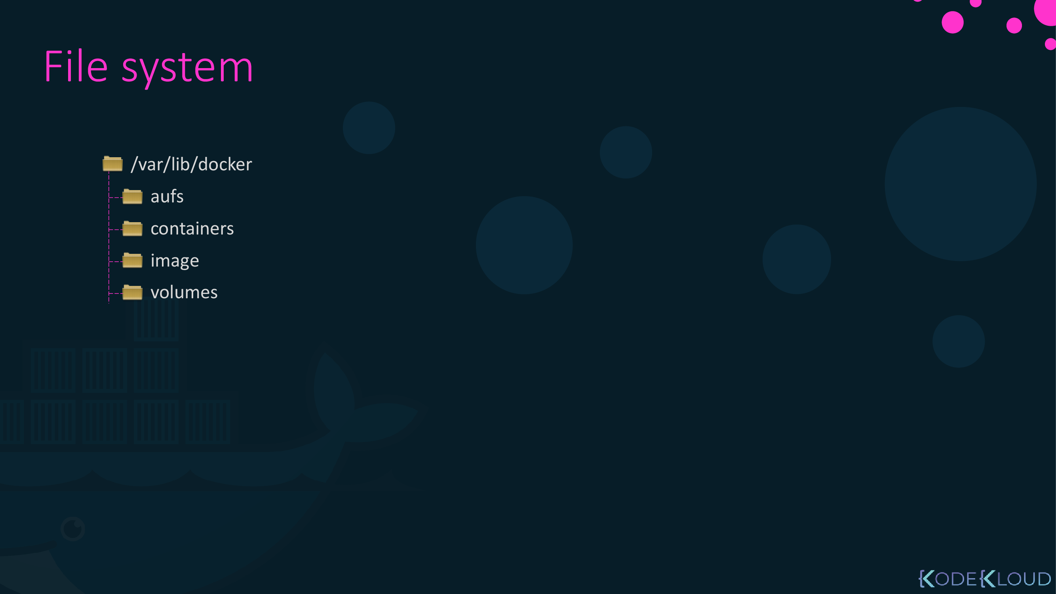

1. Application life cycle Before
and After Docker

Slide 4

End-to-end application stack
Different env. Hard to be identical.
For new onboarding developer it is very defaullt to set up identical new environmnet
High wasted resources

Slide 5
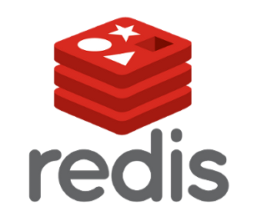


virtualization
Lib
Dep
Lib
Dep
Lib
Dep
OS
OS
OS
Mem: 30 G
CPU : 10
Mem: 40 G
CPU : 20
Mem: 25 G
CPU : 8
Hypervisor
Host OS
Hardware Infrastructure
Mem: 400 GB
CPU : 200 Cores
Notes:
the process of running a virtual instance of a computer system in a layer abstracted from the actual hardware.

Slide 6
containerization
Lib
Dep
Lib
Dep
Lib
Dep
Docker Engine
?
Host OS
Hardware Infrastructure

Slide 8
containerization vs virtualization
Utilization
Size
Boot up

Slide 10
vocabularies
Image
Single file with all the deps and config required to run a program
Container
Instance of an image. Runs a program.

Slide 13
FREE
Not Free
Image security
Image mangement
orchestration

Slide 14
Install Docker for linux
got o URL : https://docs.docker.com/engine/install/
Choose OS platform (Centos / RHEL / UBUNTU /…. )
To check you OS Platform tun this command : $ cat /etc/*release
Follow the steps on the URL :
Uninstall previous version
Install Docker

Slide 15
Install Docker for Windows or mac
You have 2 Options:
1- install Docker Desktop for Windos/Mac
2- Install Virtualbox and deploy a Linux VM and then follow the upcoming demo to install Docker on that Linux VM.
Then follow the previous steps for installing docker on linux

Slide 16
What is Docker ?
Docker Client
Docker Server
Docker Machine
Docker Images
Docker HUB
Docker Compose
Docker is a platform or ecosystem around creating and running something called containers.
Docker is a tool designed to make it easier to create, deploy, and run applications by using containers.

Slide 17

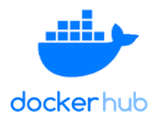
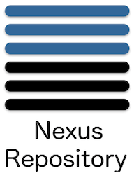
Types of Docker regestries
Public regestry
Private regestry

Slide 18
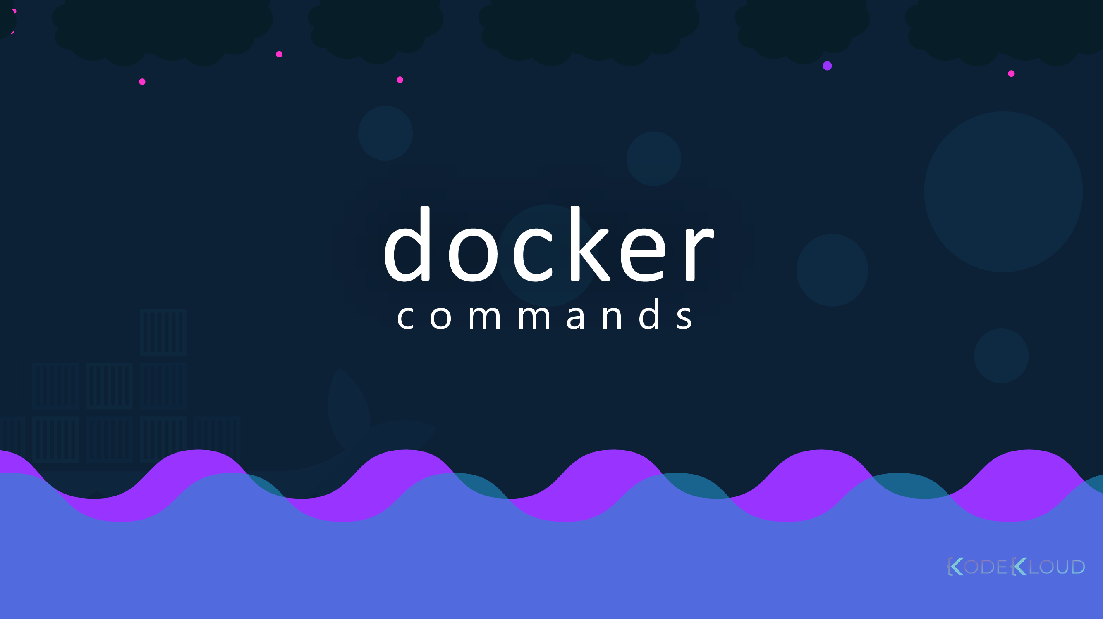

Slide 19
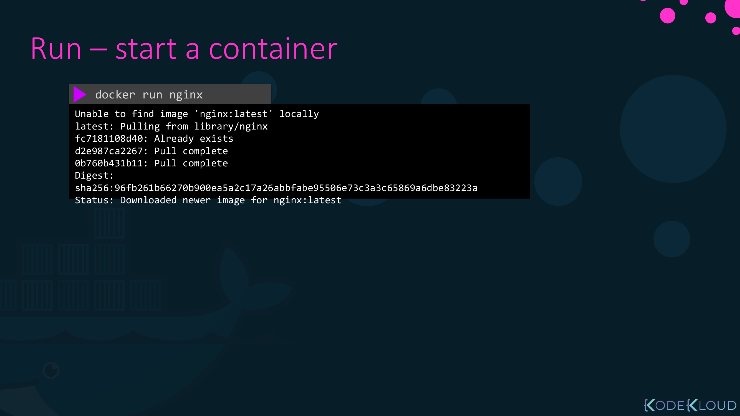
Run – start container in background
$ docker run -d nginx

Slide 20
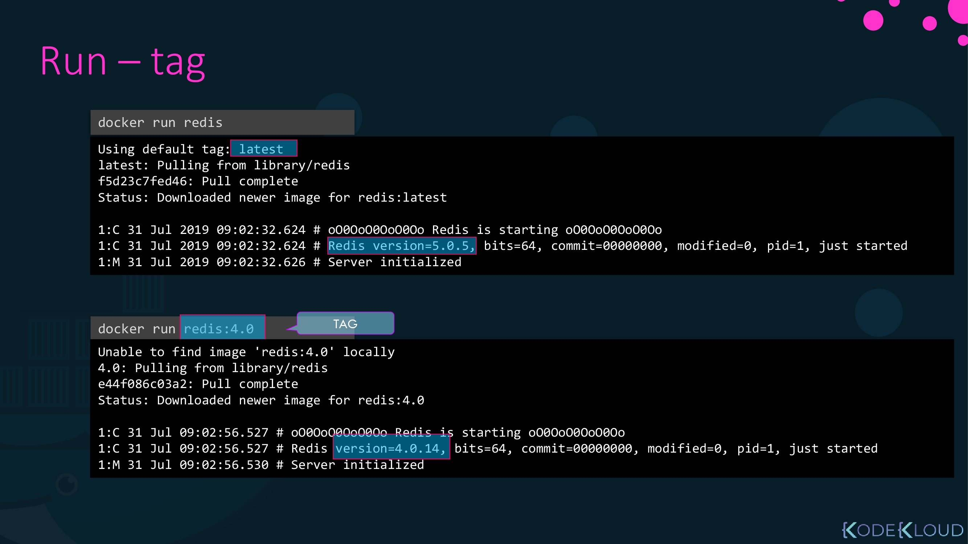
Run specific version .

Slide 21
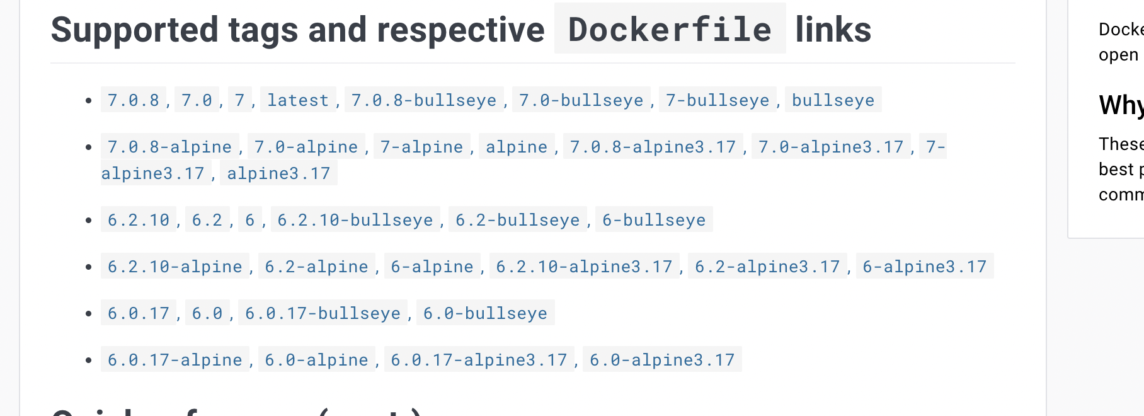
How can you check the app version :
From docker hub itself

Slide 22
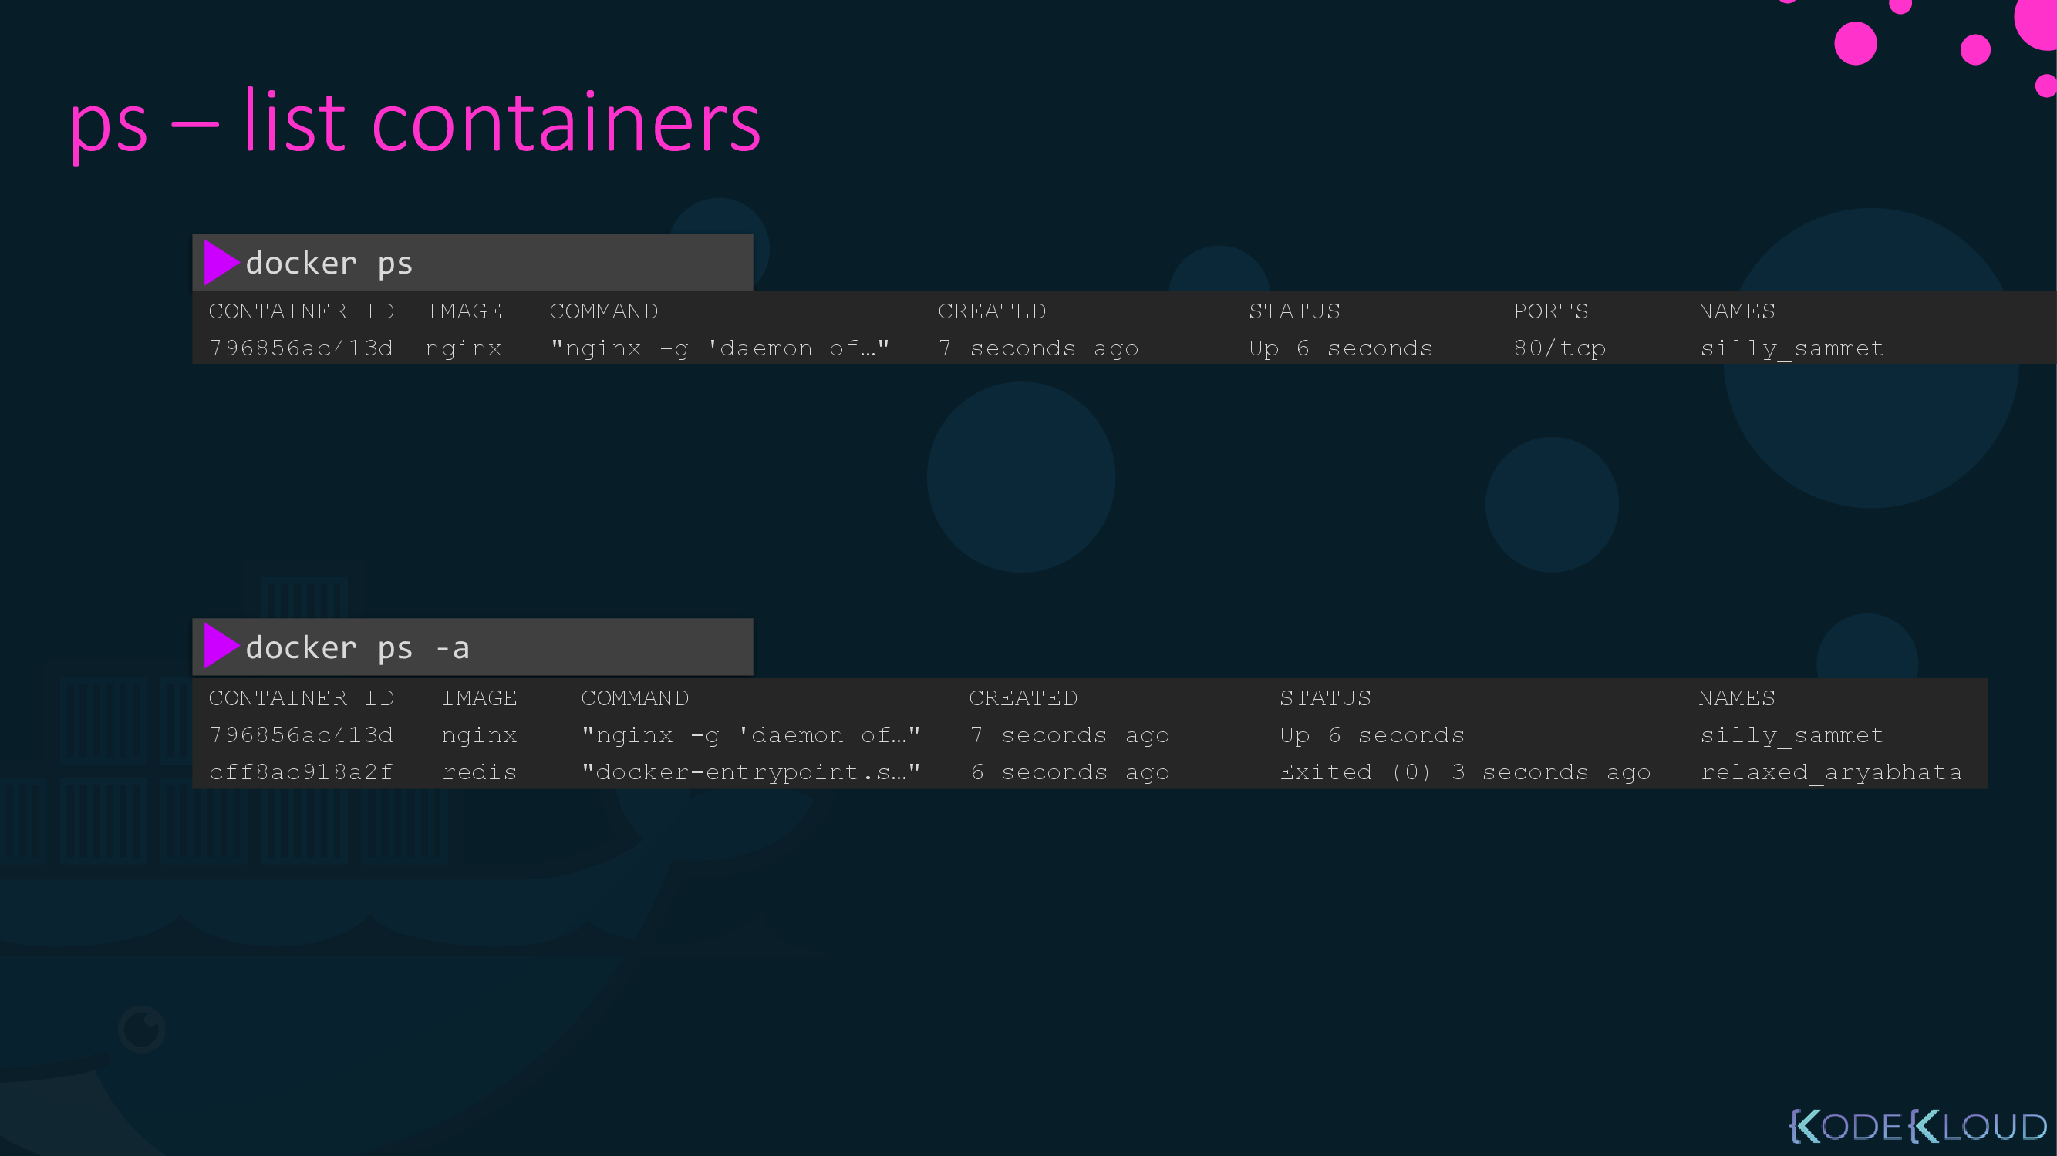

Slide 23
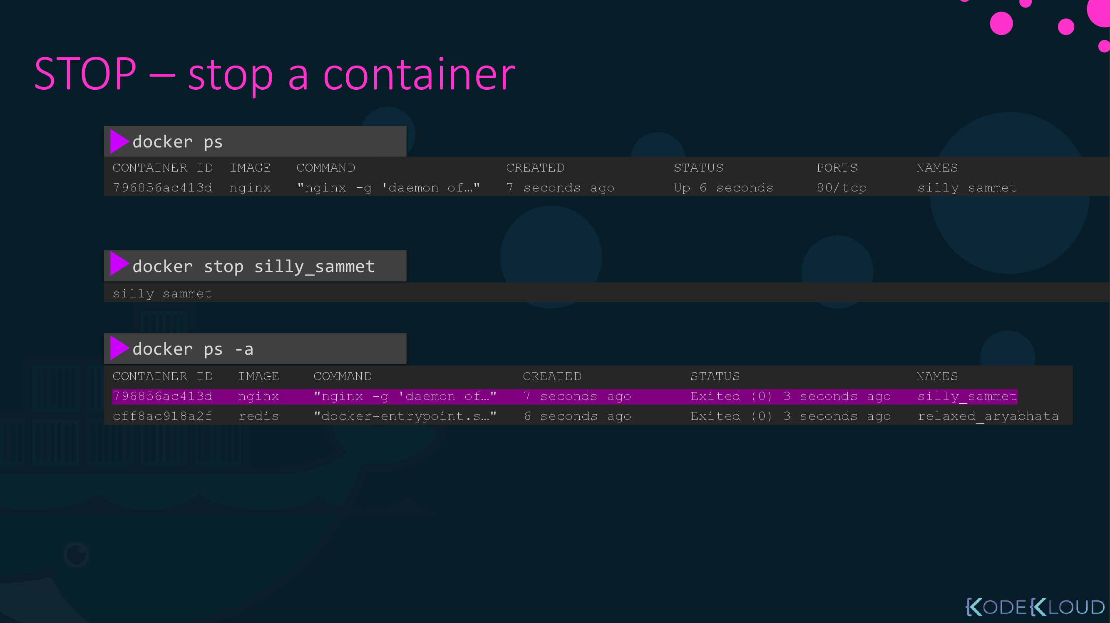

Slide 24
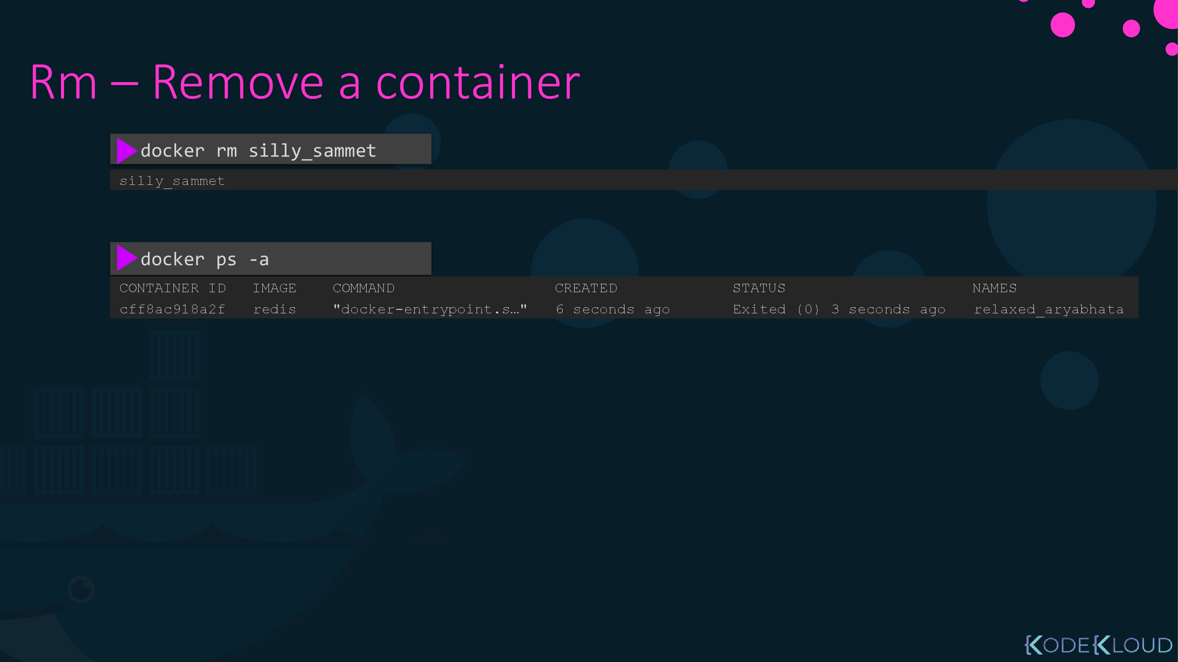

Slide 25
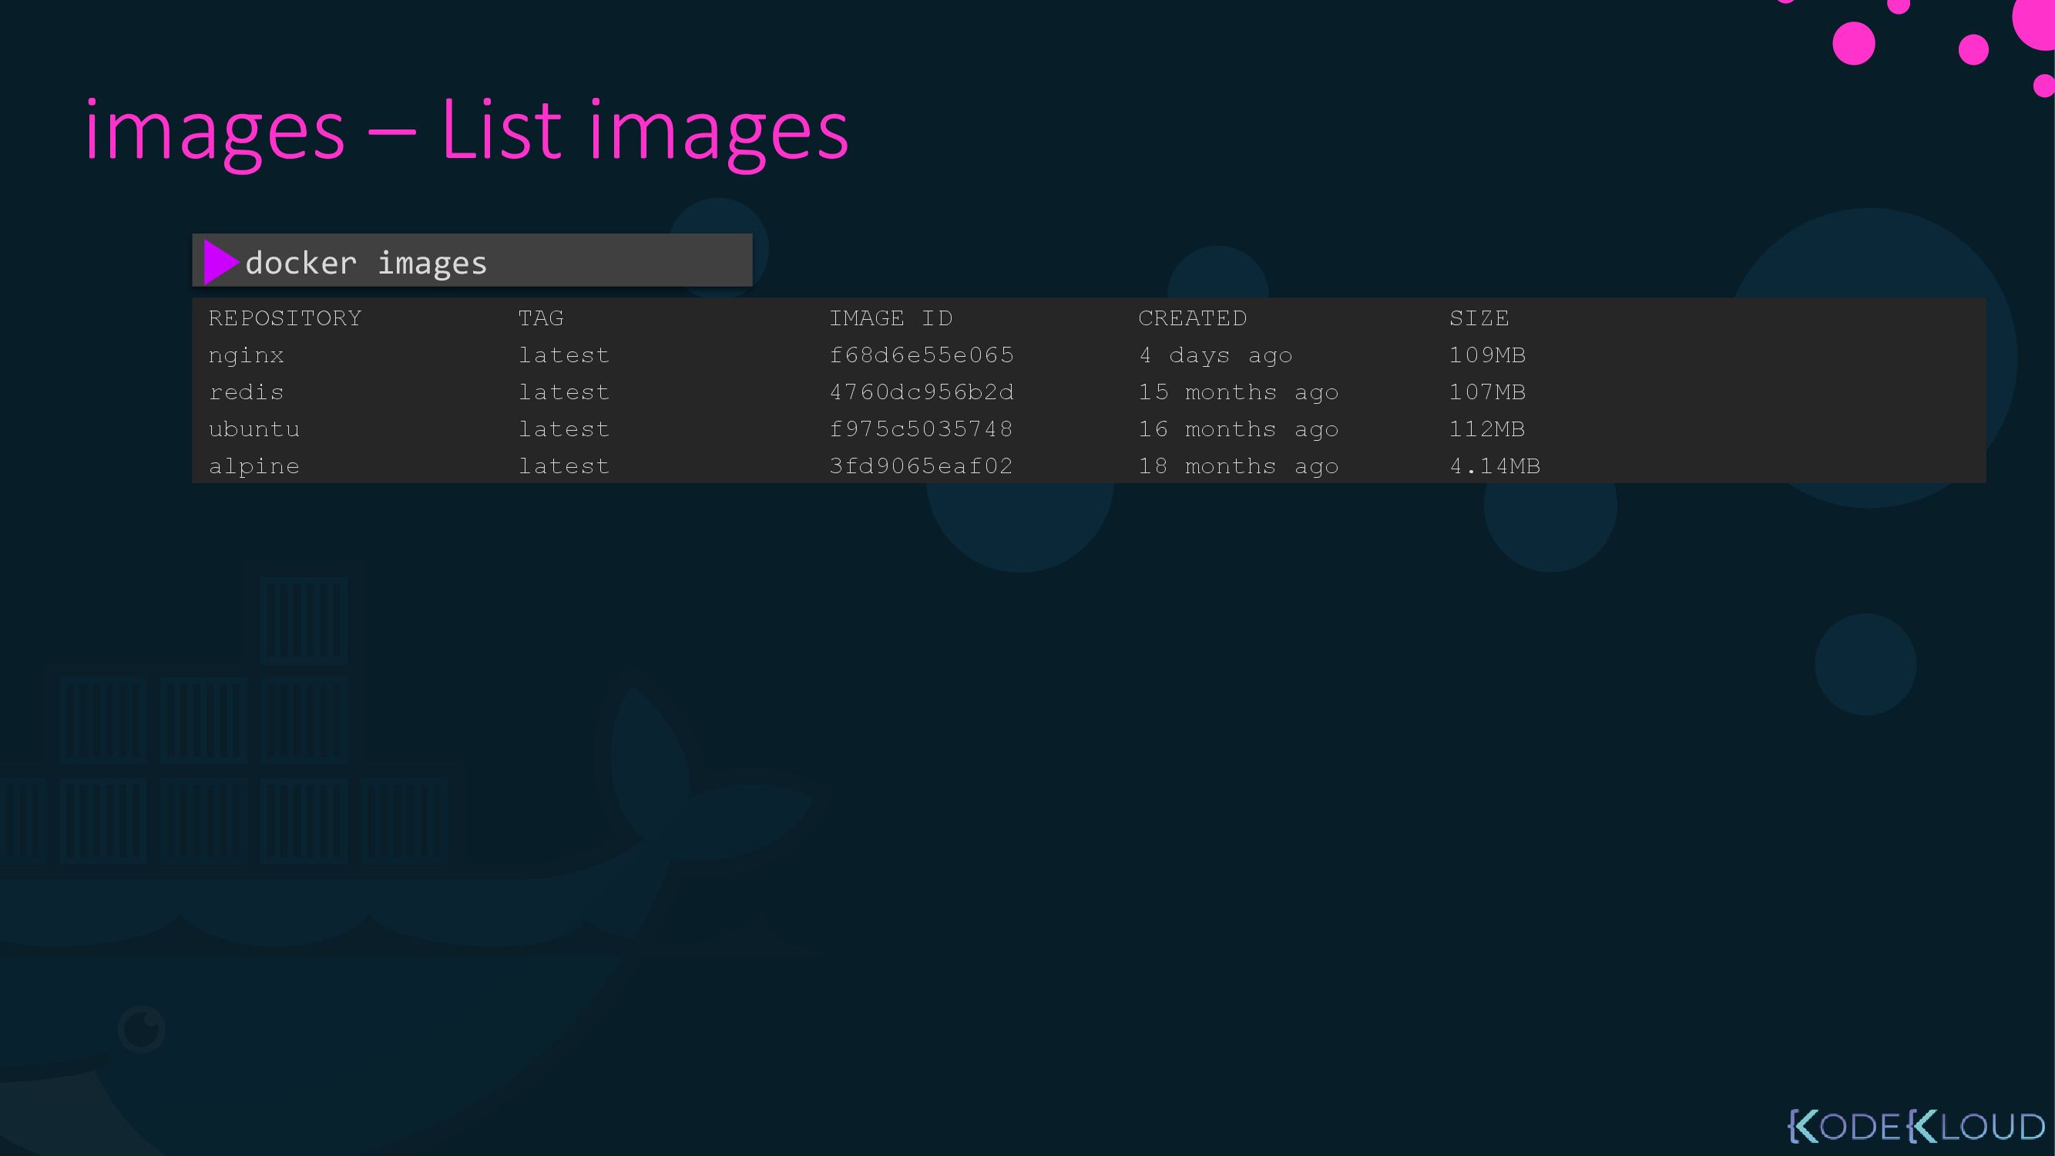

Slide 26
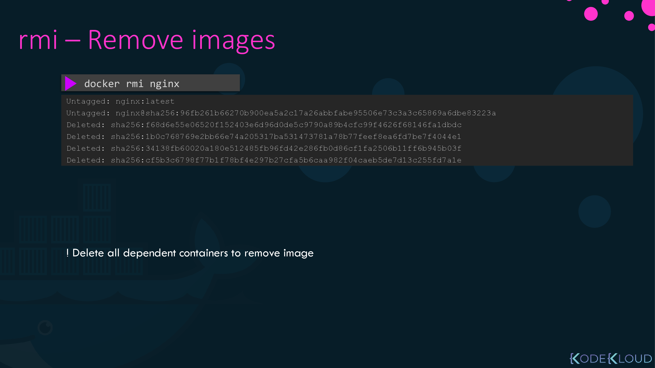
Or $ docker image rm nginx
Note: you have to delete container first before you delete image

Slide 27
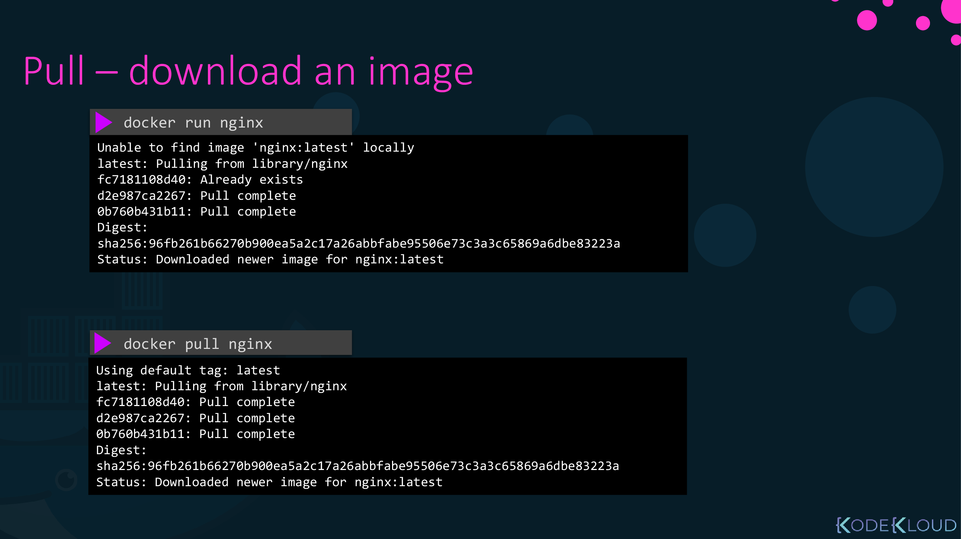
Download Image only and not run it

Slide 28
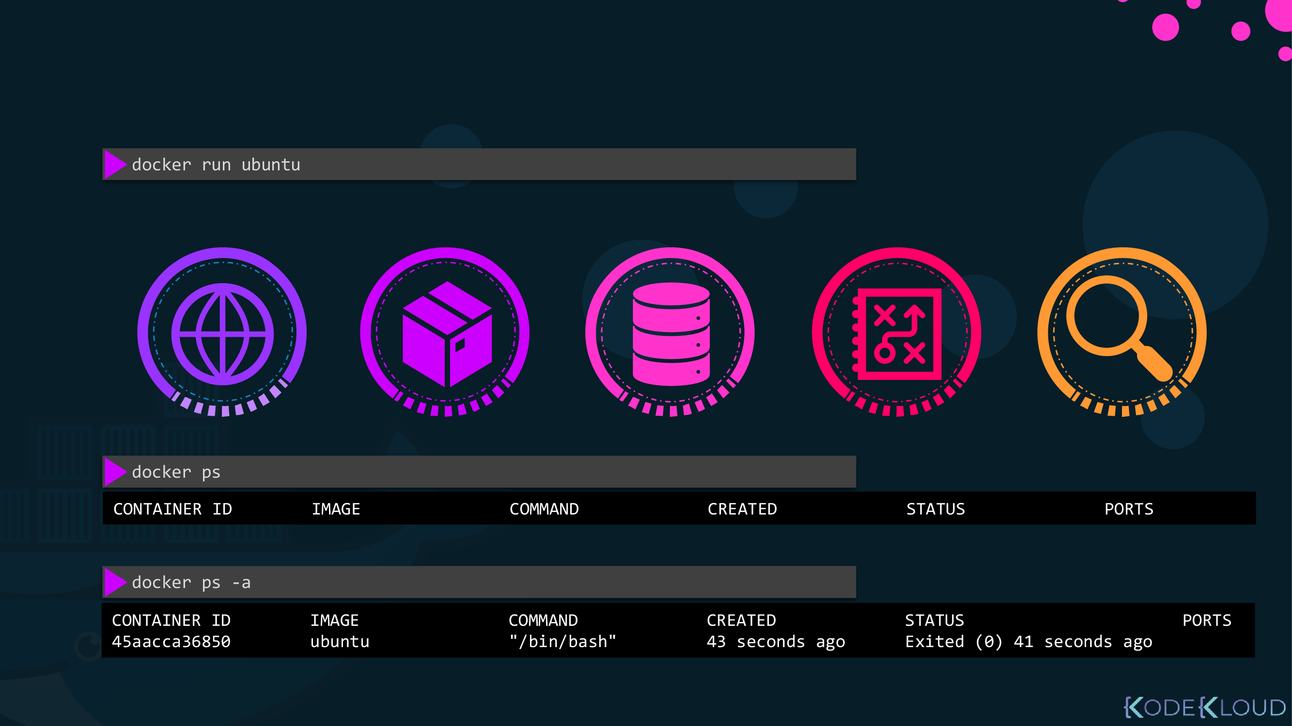
Notes here when run UBUNTU container it exited directly ,
Becausee contaienrs aren’t Operting system ,
Theu just start and run a job then exited

Slide 29
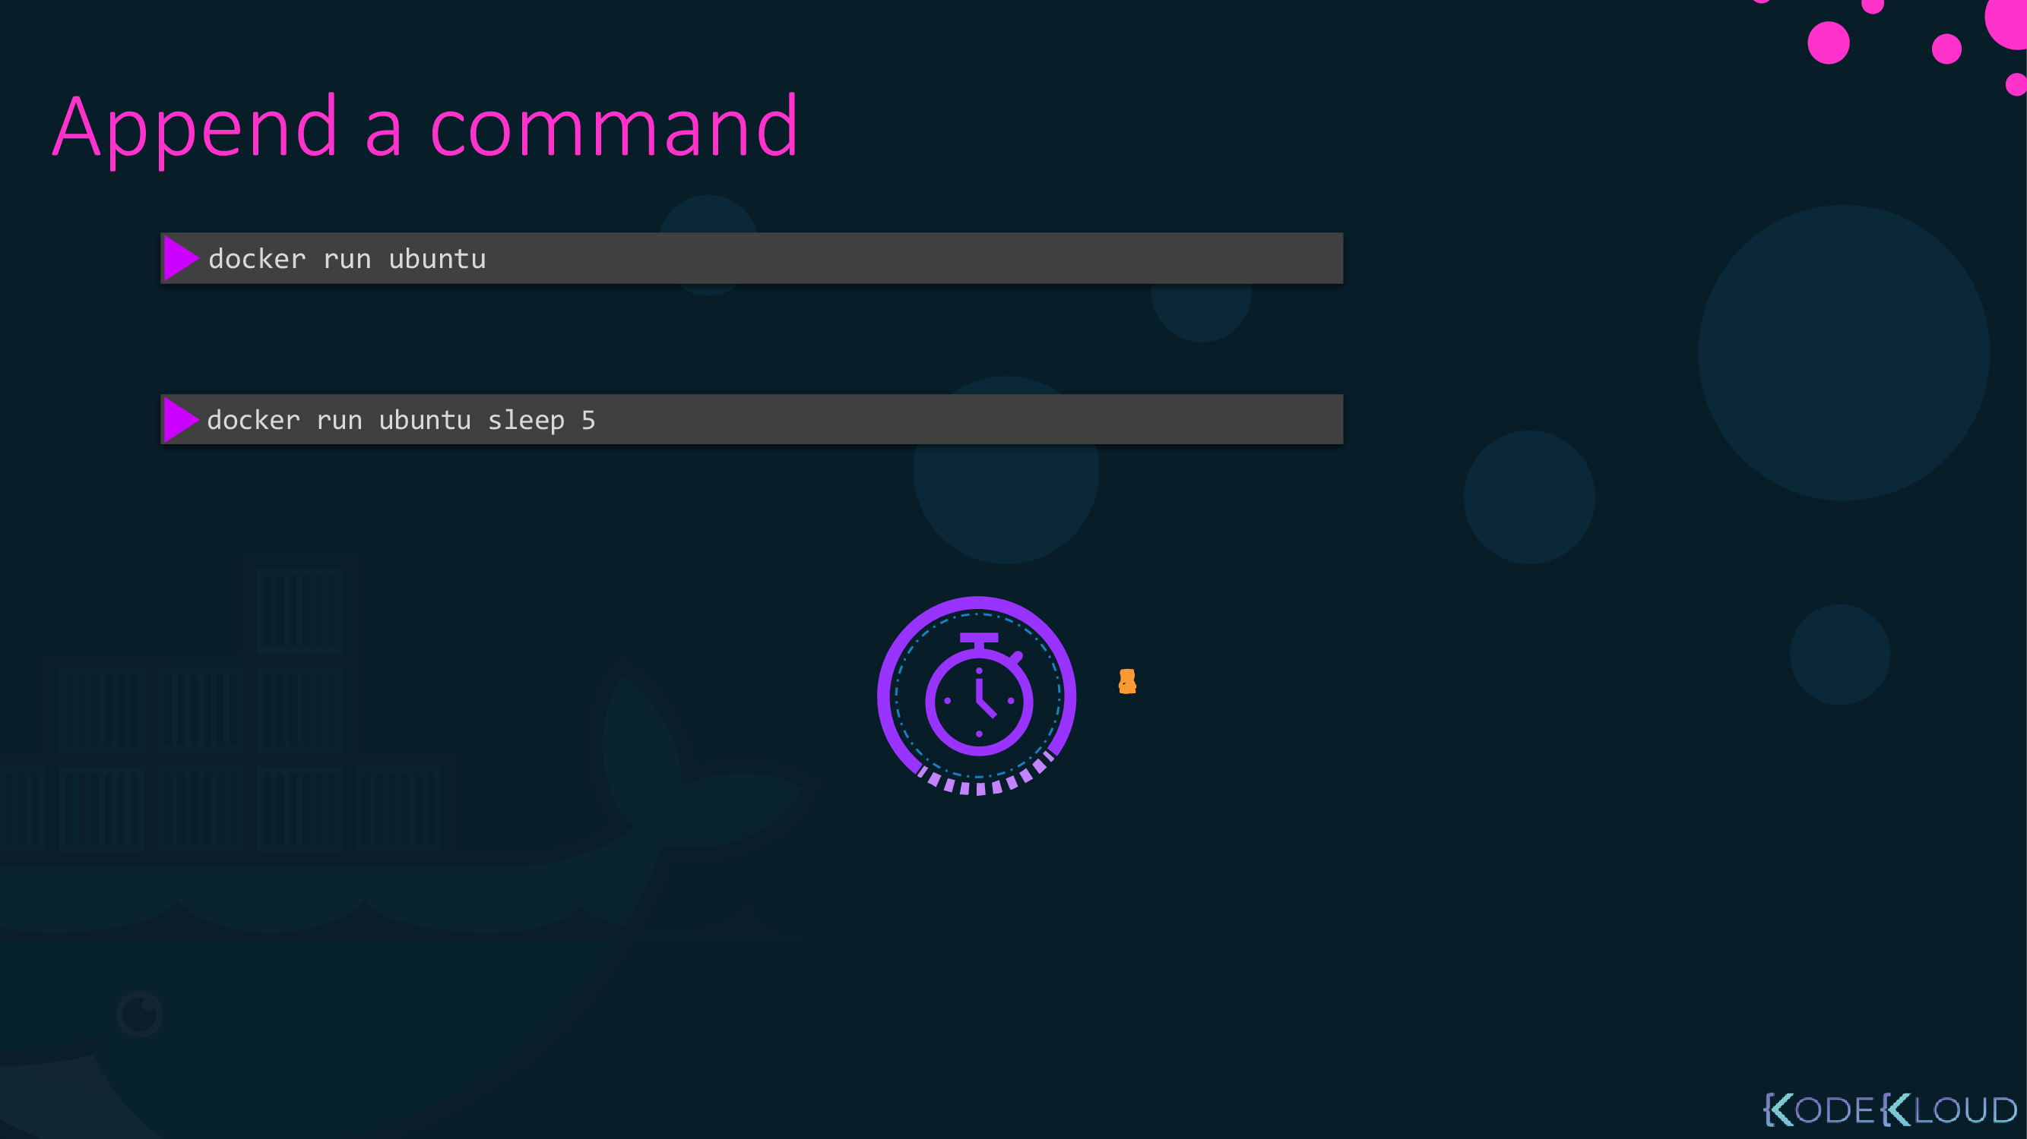
You can append a command to do before it is up

Slide 30
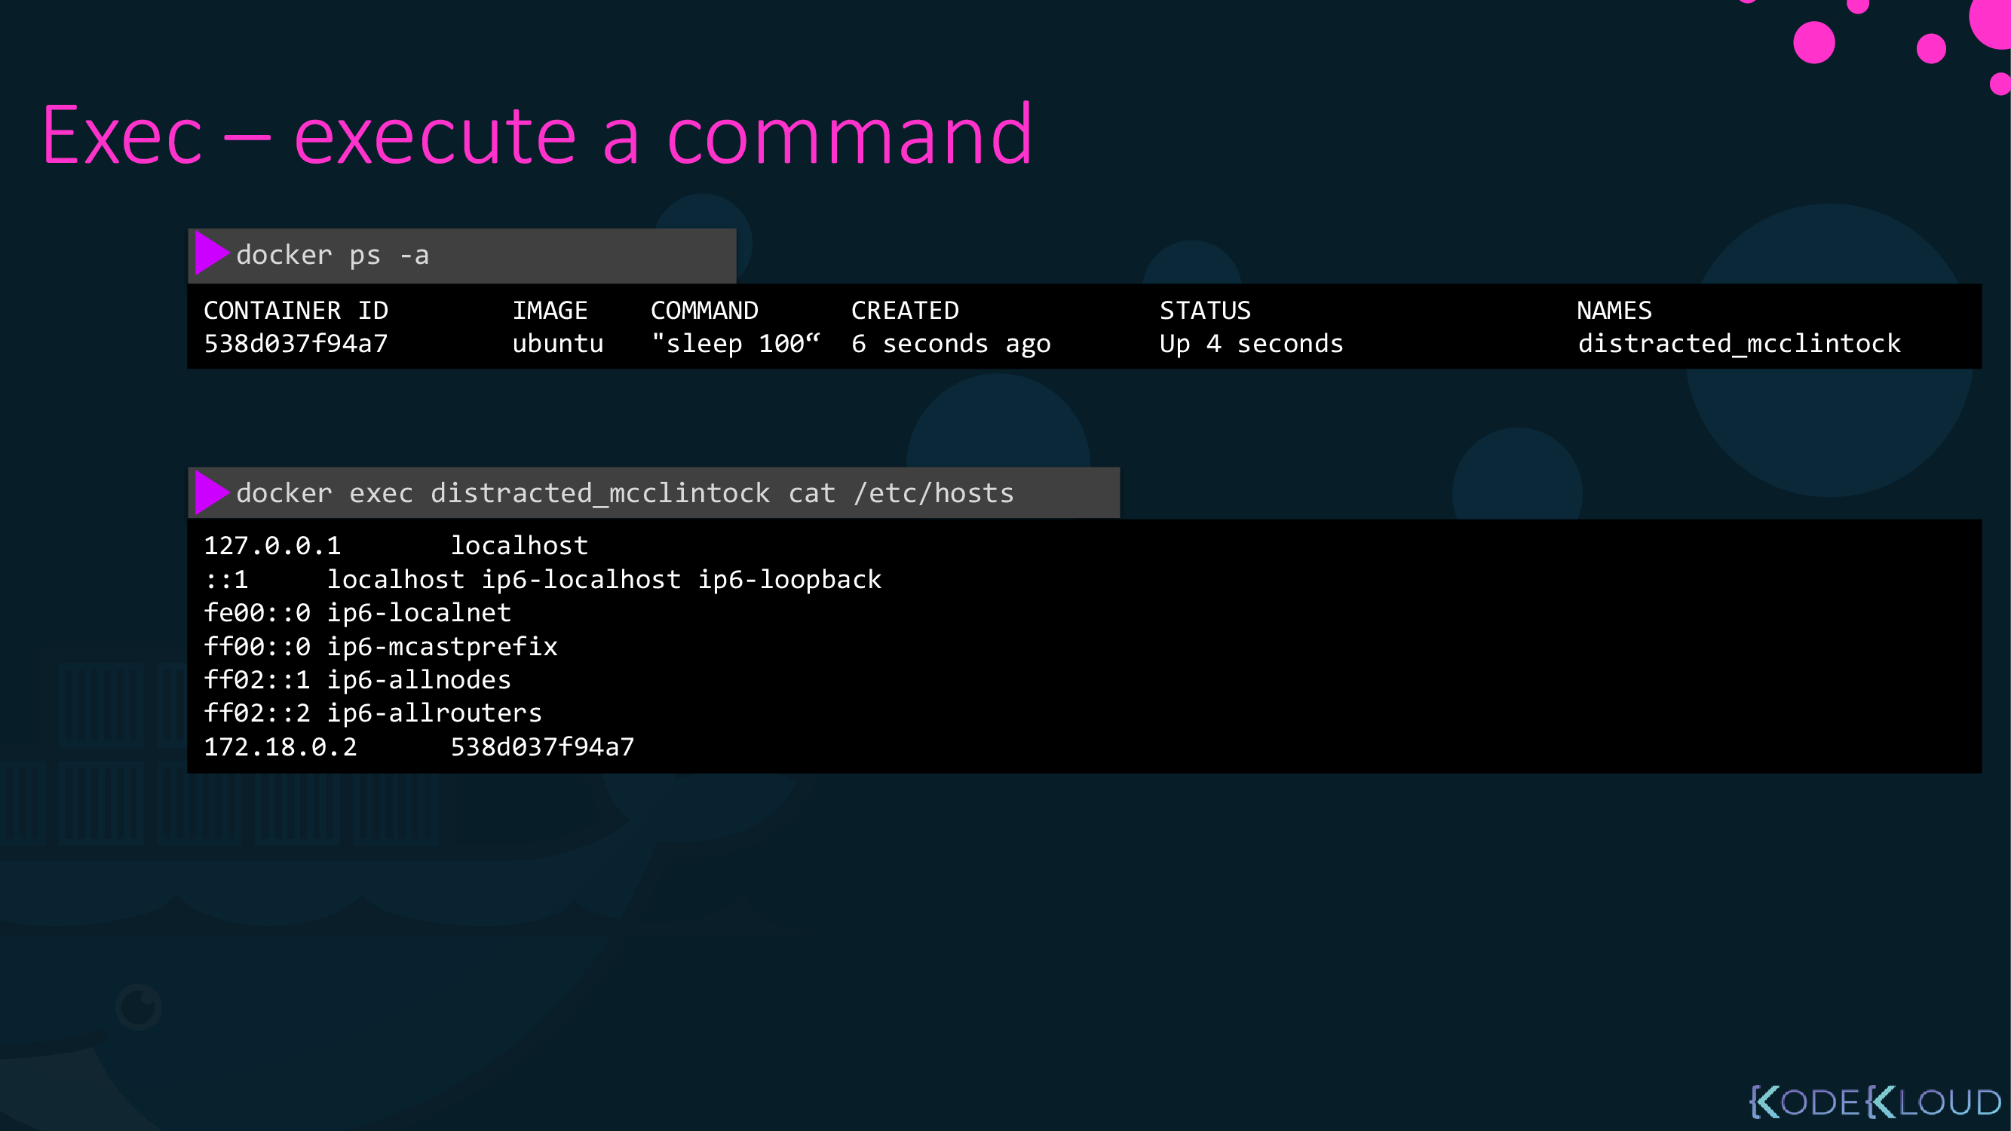

Slide 31
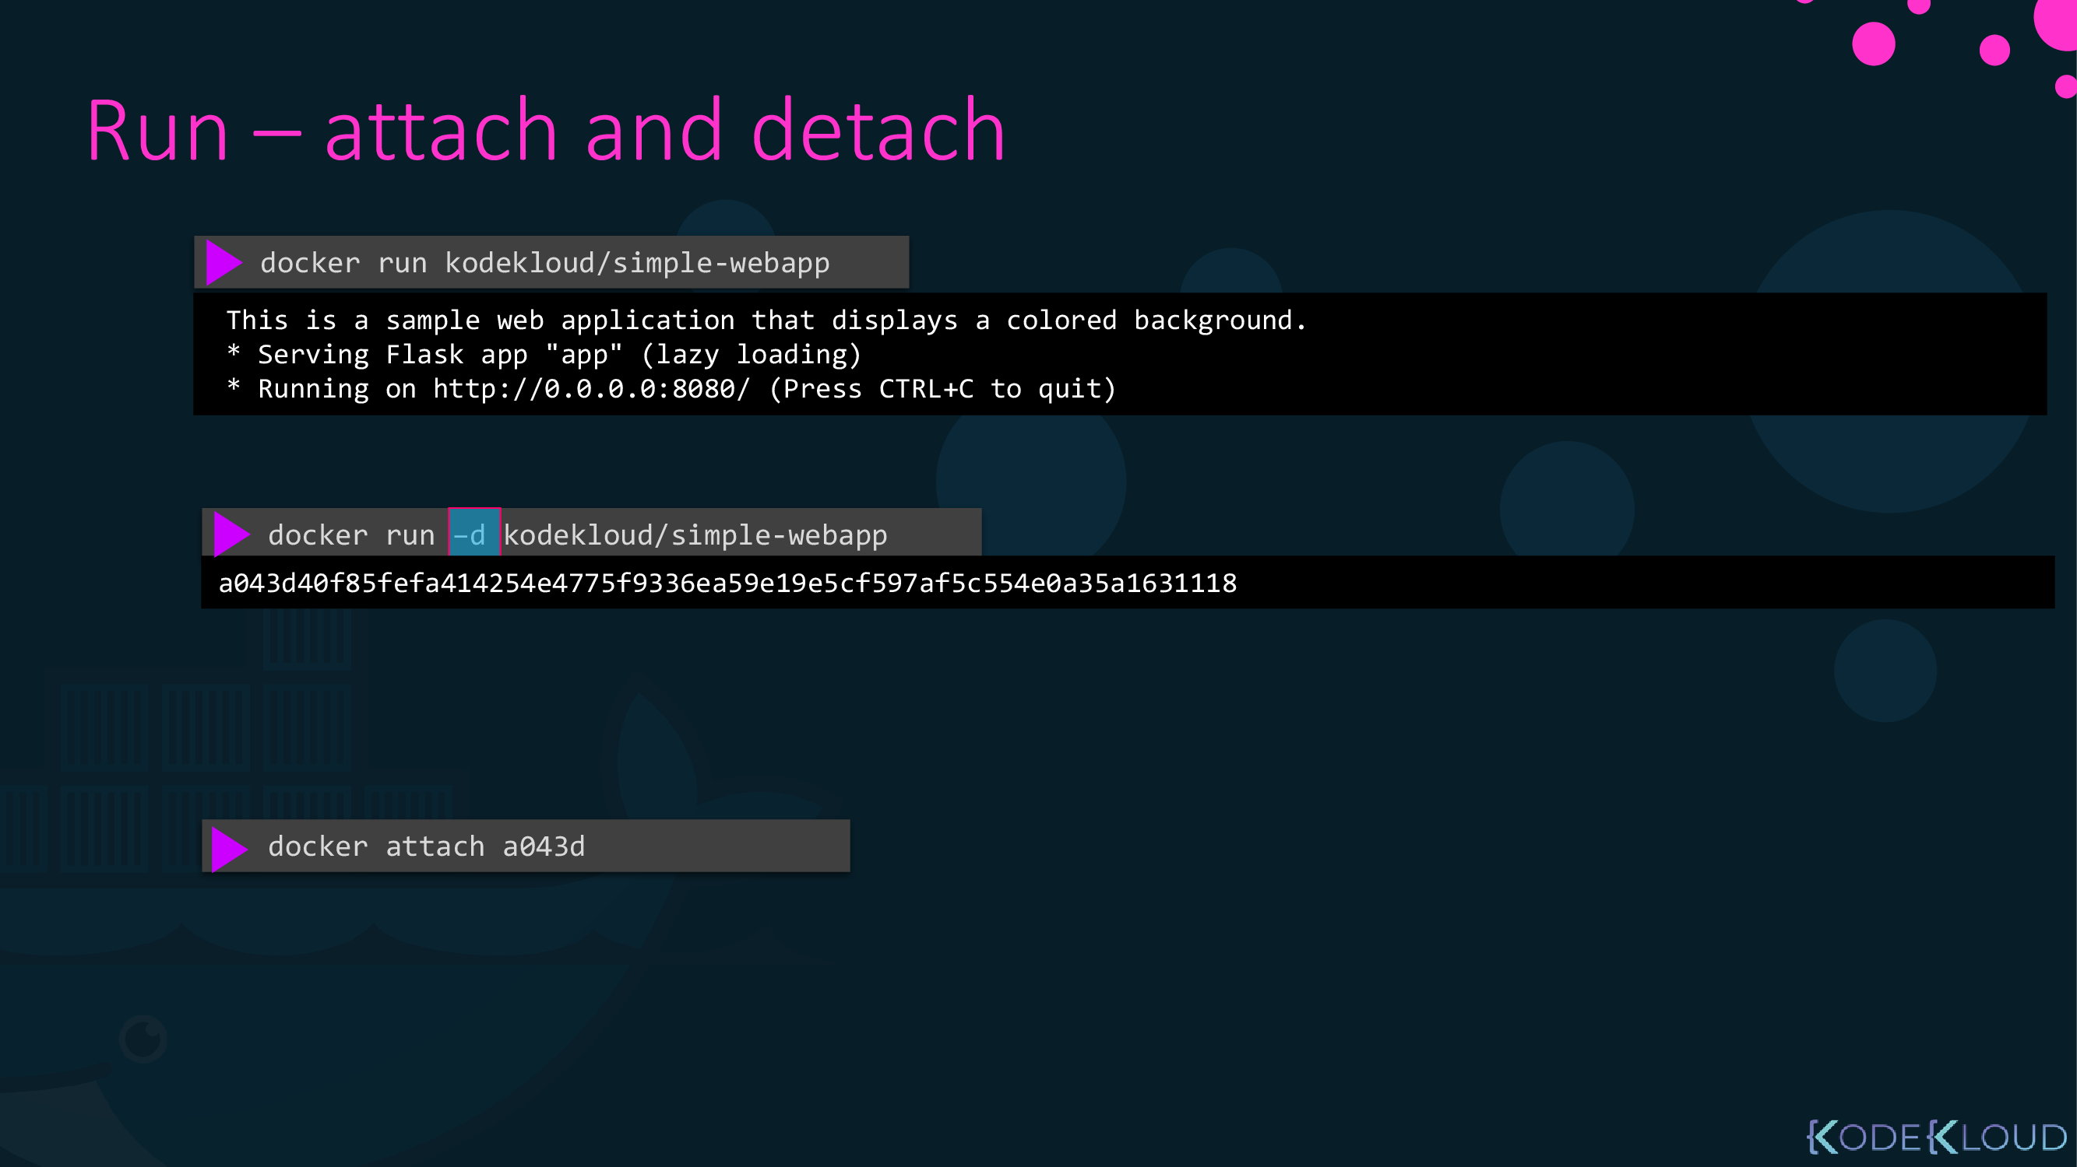
You show output of conatiner on terminal and canoot do anything else on this terminal
Run container in the background as daemon
to show container terminal output again use attach option with container id or name

Slide 32
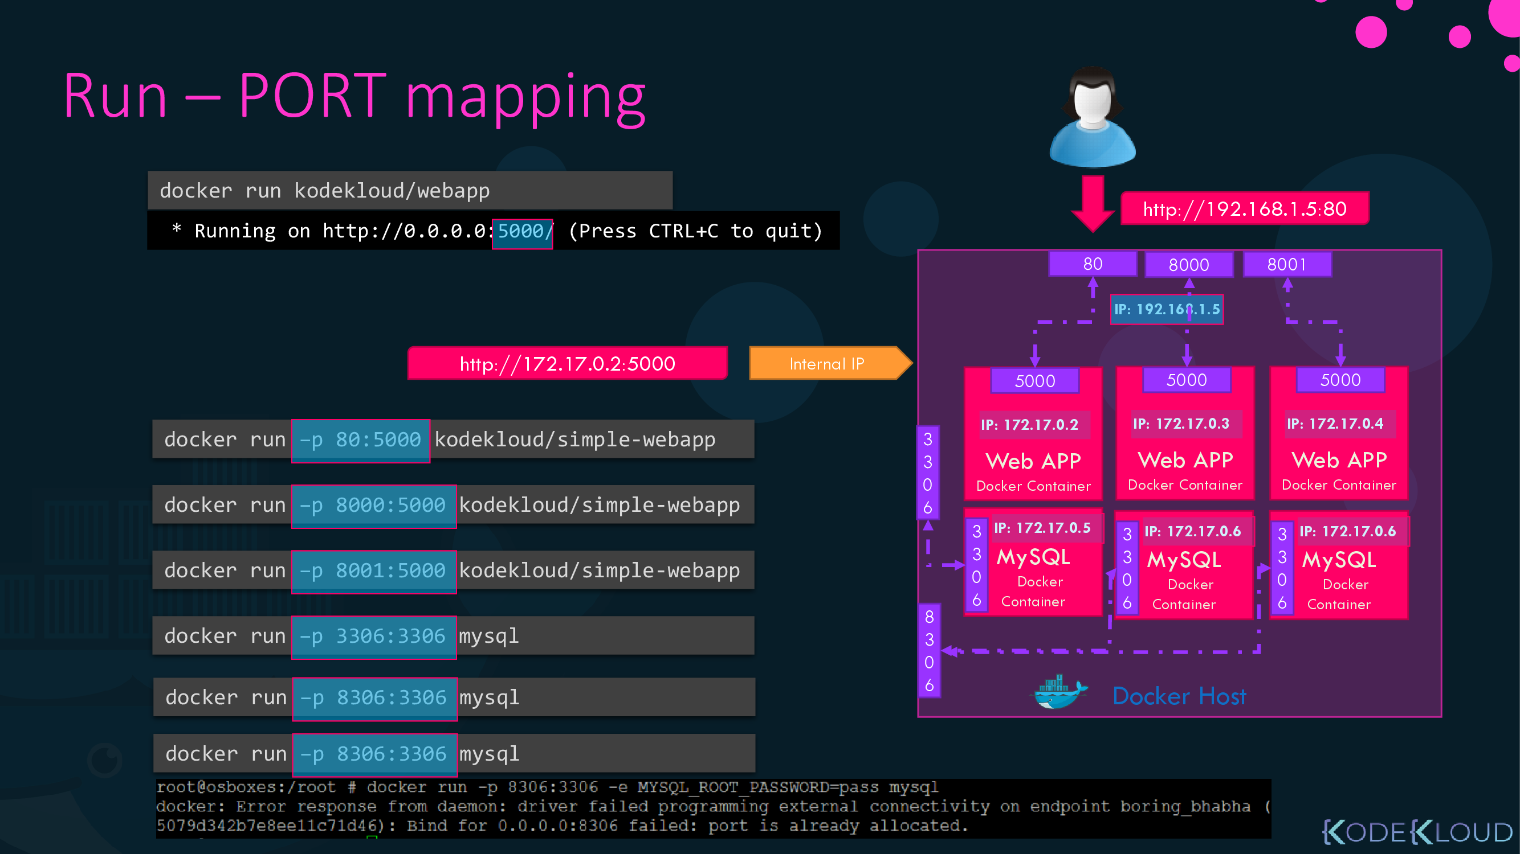

Slide 33
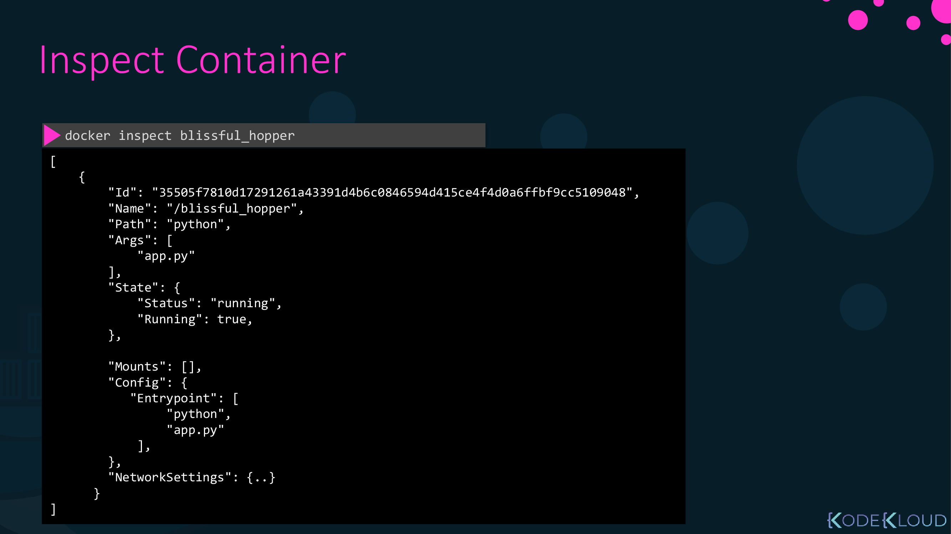

Slide 34
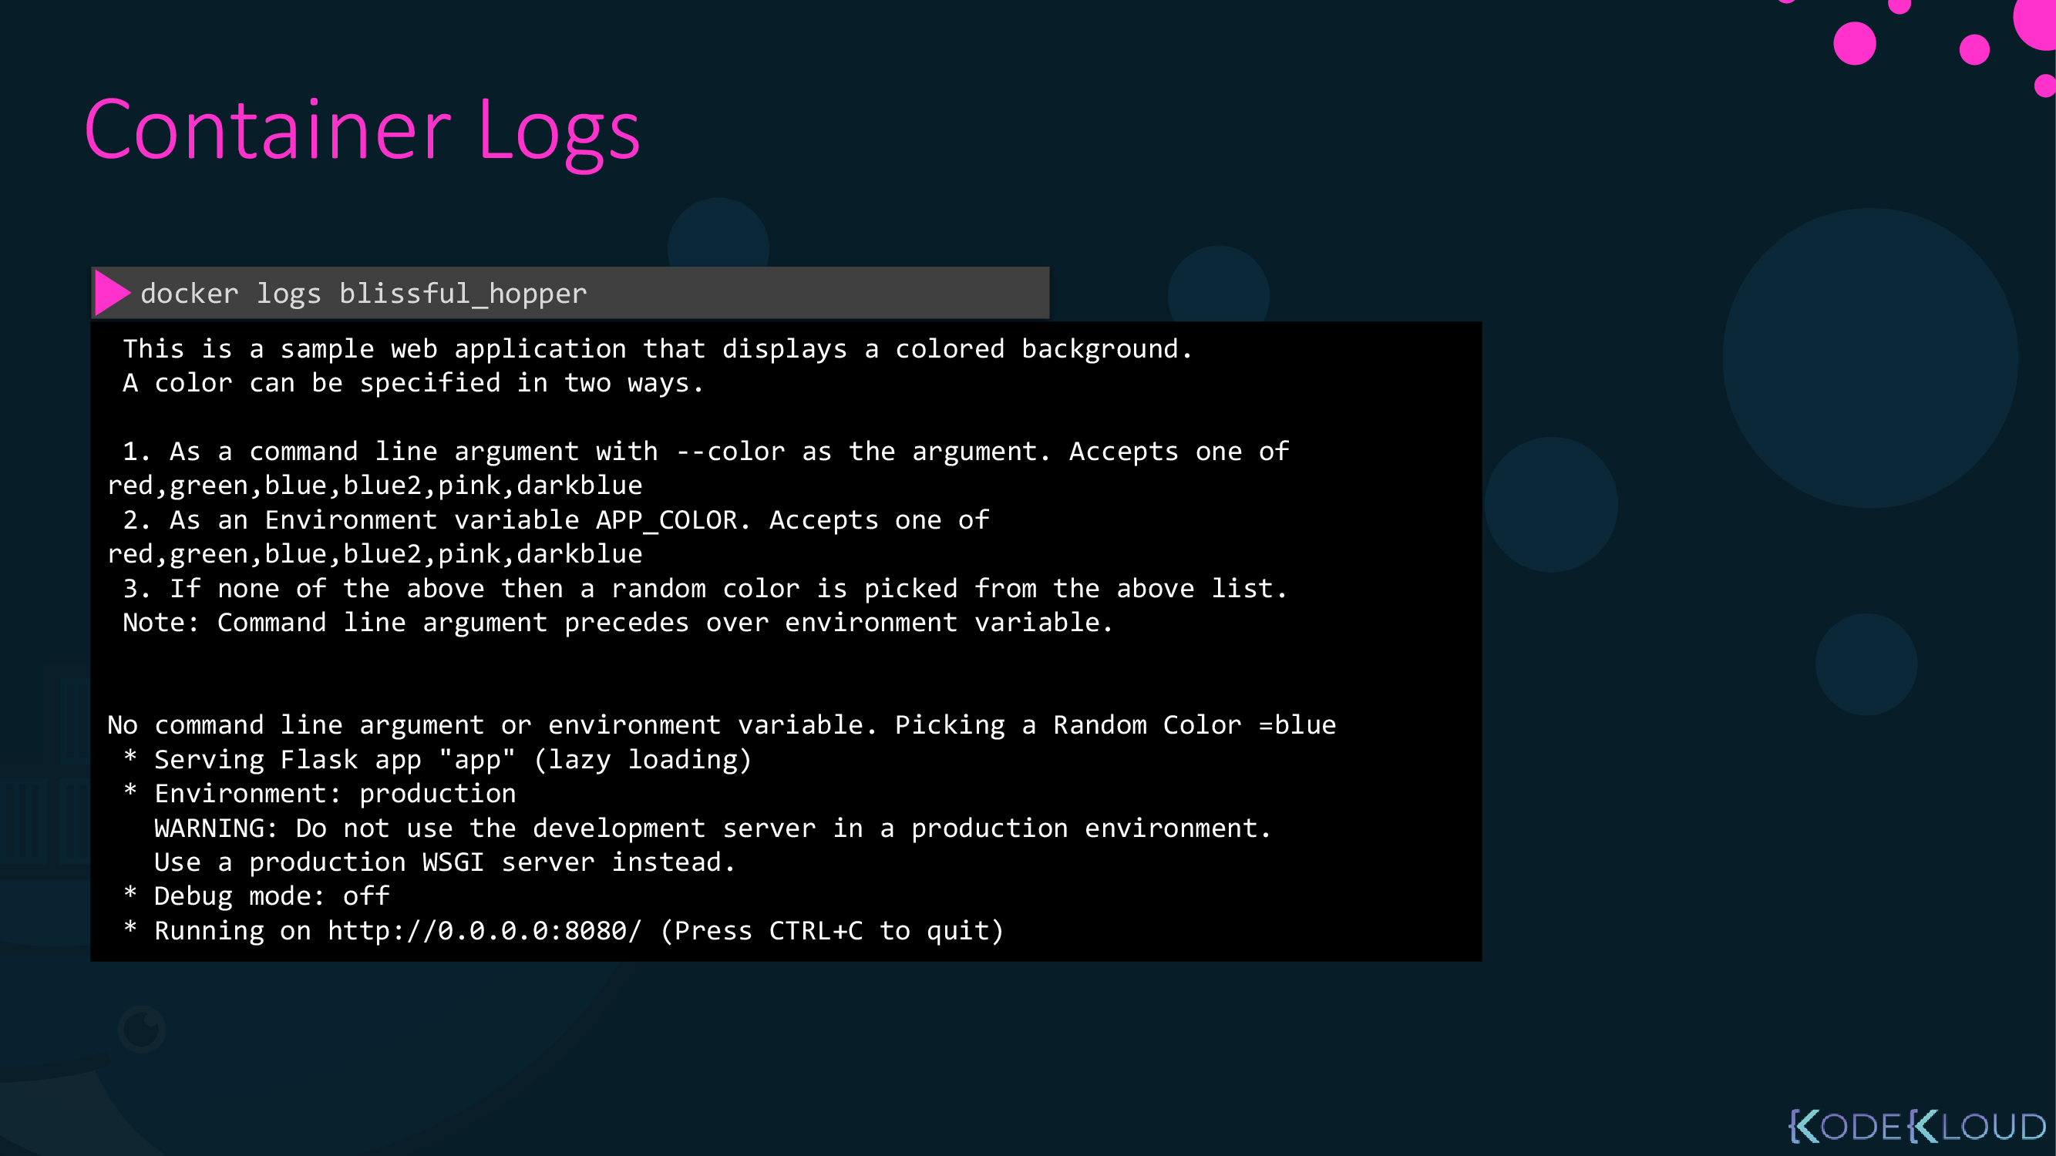

Slide 35
Docker Basic Commands
Run Container
$ docker run <image-name>
Overriding default command
$ docker run <image-name> <command!>
Attached and Detached
$ docker run –d <image-name>
$ docker attach <container ID>
Interactive mode
$ docker run -i <image-name>
Port mapping
$ docker run –p host:container <image-name>
Volume mapping
$ docker run –v host:container <image-name>
Inspect container
$ docker inspect <container-name>
Stop container
$ docker stop CONTAINER
List all images
$ docker images -a
List all containers
$ docker ps -a

Slide 36

Container Lifecycle

Slide 37
Container Lifecycle
docker run:
Create: take file system snapshot and add as a process ready to run in hard drive.
Start: Run start up command
Exited: finished its job and exit.
docker stop: terminate single but wait
docker kill: force terminate
docker prune: clear docker caches, images and stopped containers.

Slide 38
Docker Volumes

Slide 39
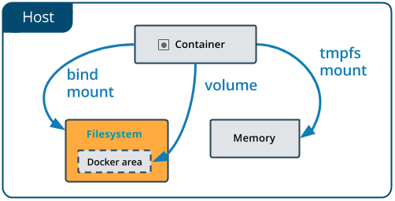
Docker Volumes
Bind Mount:
a file or directory on the host machine is mounted into a container
The file or directory is referenced by its absolute path on the host machine
-v /data:/usr/share/nginx/html
-v /usr/share/nginx/html
Volume:
a new directory is created within Docker’s storage directory on the host machine, and Docker manages that directory’s contents.

Slide 40
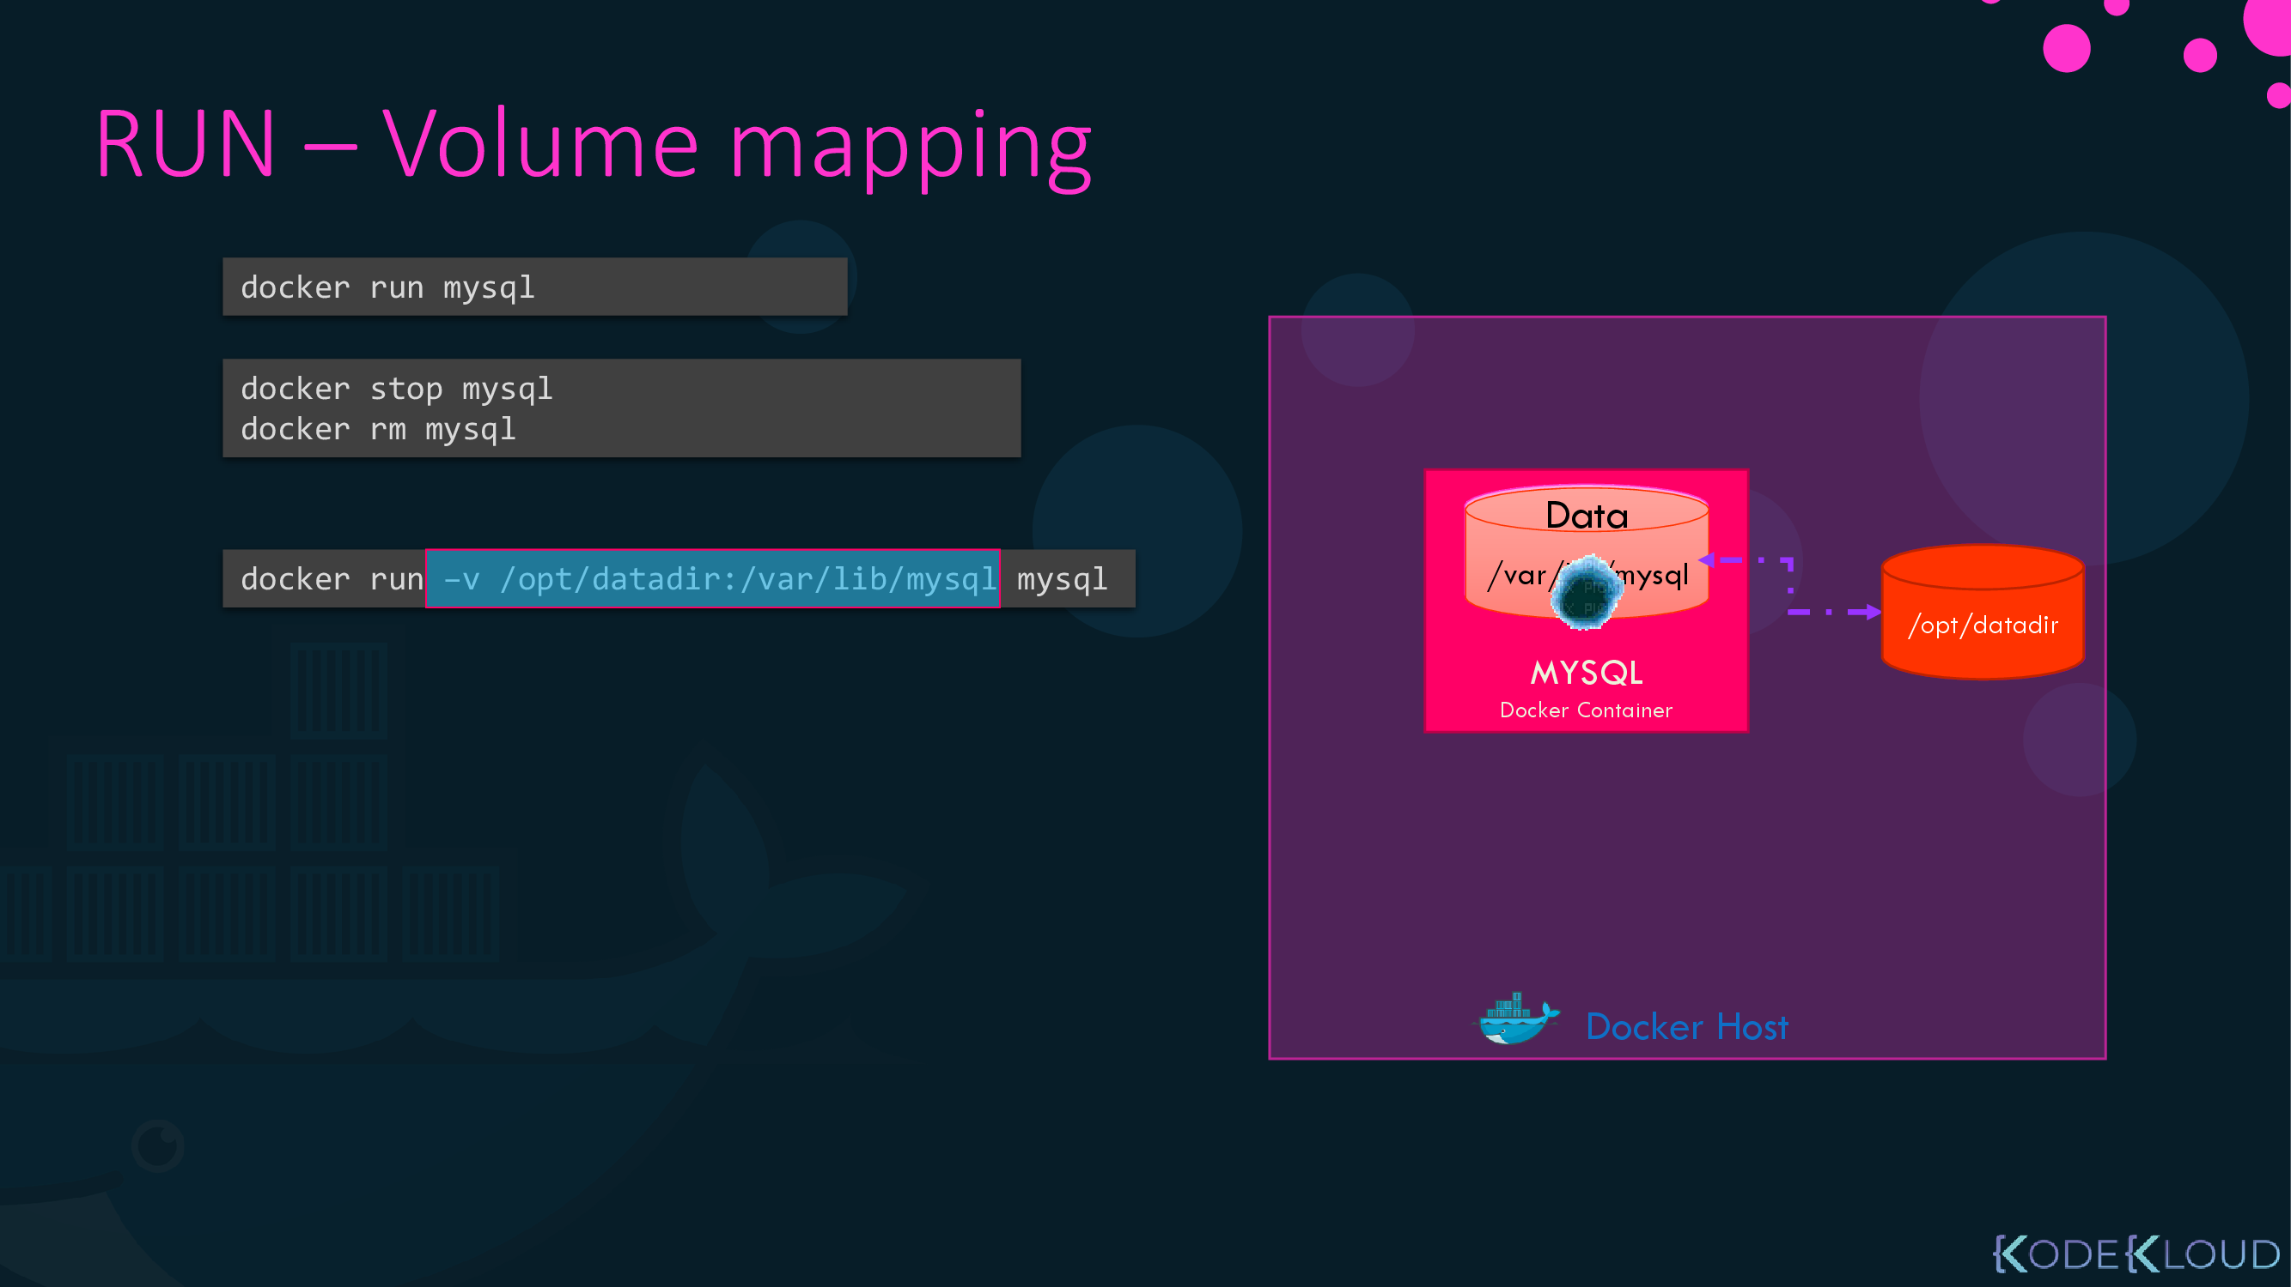

Slide 42

Break

Slide 43

Lab

Slide 44
Problem 1
Run the container hello-world
Check the container status
Start the stopped container
Remove the container
Remove the image

Slide 45
Problem 2
Run Alpine container with –it and sh
Create file newfile
Exit from container , check status
Remove container .

Slide 46
Problem 3
Run a container nginx with name web and attach a bind mount to the container
directory for containing static html file (index.html ) , file contains ➔ New WOrld
container directory /usr/share/nginx/html
Remove the container
Run a new container with the following:
Attach the directory that was attached to the previous container
Map port 80 of container to port 9898 on you host machine
Access the html files from your browser

Slide 47
Problem 4
Run the image nginx again without attaching any volumes
Add html static files (/usr/share/nginx/html/index.html) to the container and make sure they are accessible
Commit the container with image name my-server
Run new container with static-server with image my-server ,

Slide 48
Problem 5
Create a volume called mysql_data, then deploy a MySQL database called app-database. Use the mysql latest image, and use the -e flag to set MYSQL_ROOT_PASSWORD to P4sSw0rd0!
Mount the mysql_data volume to /var/lib/mysql. The container should run in the background.
Can check by using command inside container
mysql mysql -p P4sSw0rd0!

Slide 49
DeepDive on Docker

Slide 50
create postgres container with named volume psql-data
Using version 14
Container name will be postgres
Volume path to postgress data is /var/lib/postgresql/data
Use –e flag to pass POSTGRES_PASSWORD=password
Then mount container port 5432 to host port 5432
Container should run in the background
Create database inside it .
Stop the container .
Recreate another postgres container with version 15 and mounted to the same volume ,
did postgress is initialized?, Check container logs .
Test
psql -h 192.168.64.23 -p 5432 -U postgres
Postgres# \l ➔ list all databse
Postgres# create database test; ➔ must contains “;”

Slide 51
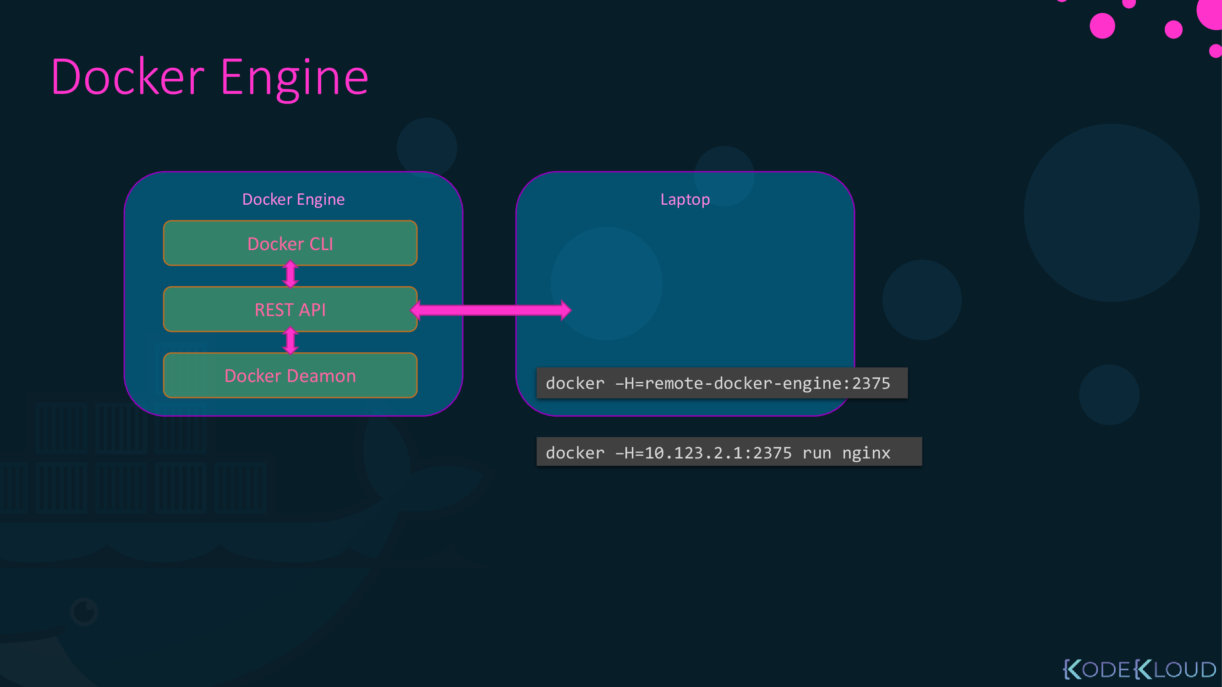

Slide 52
Thanks for attention

